Slide 1
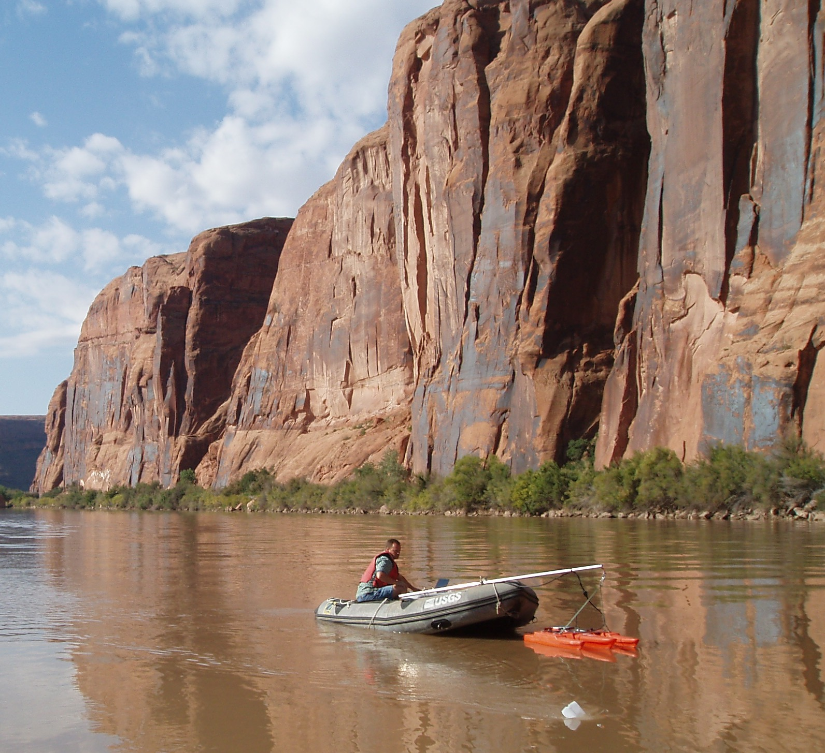
Manned Boat ADCP Deployment

Slide 2
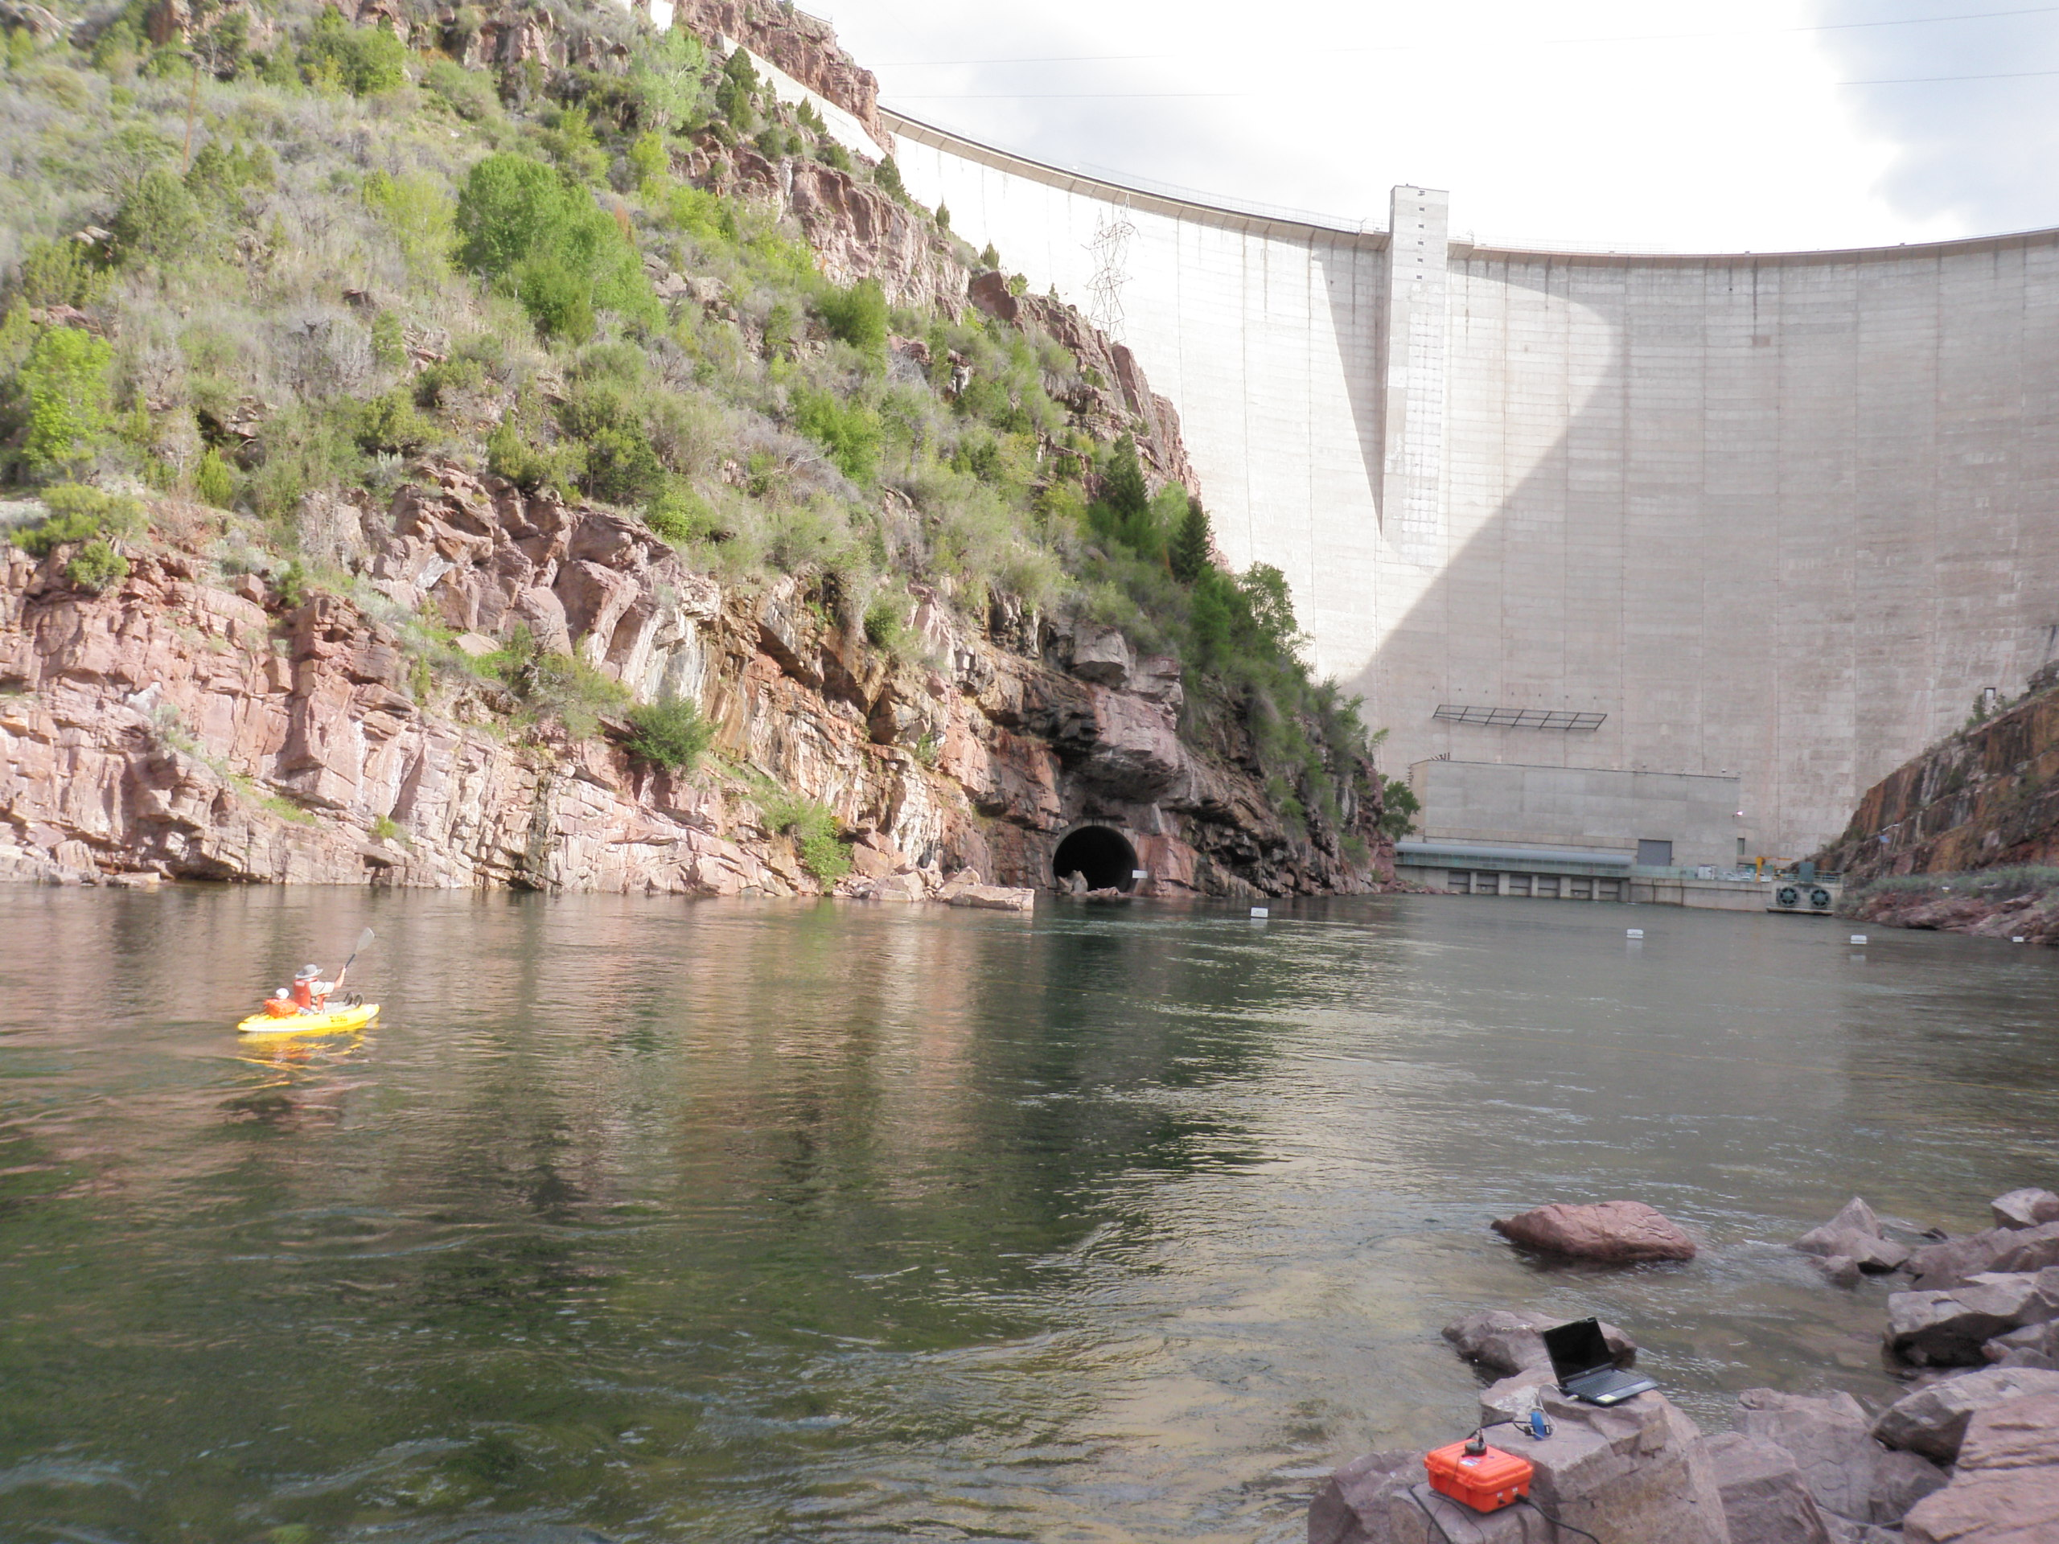
ADCP Transducer Deployed Through Hole in Bottom of Kayak

Slide 3
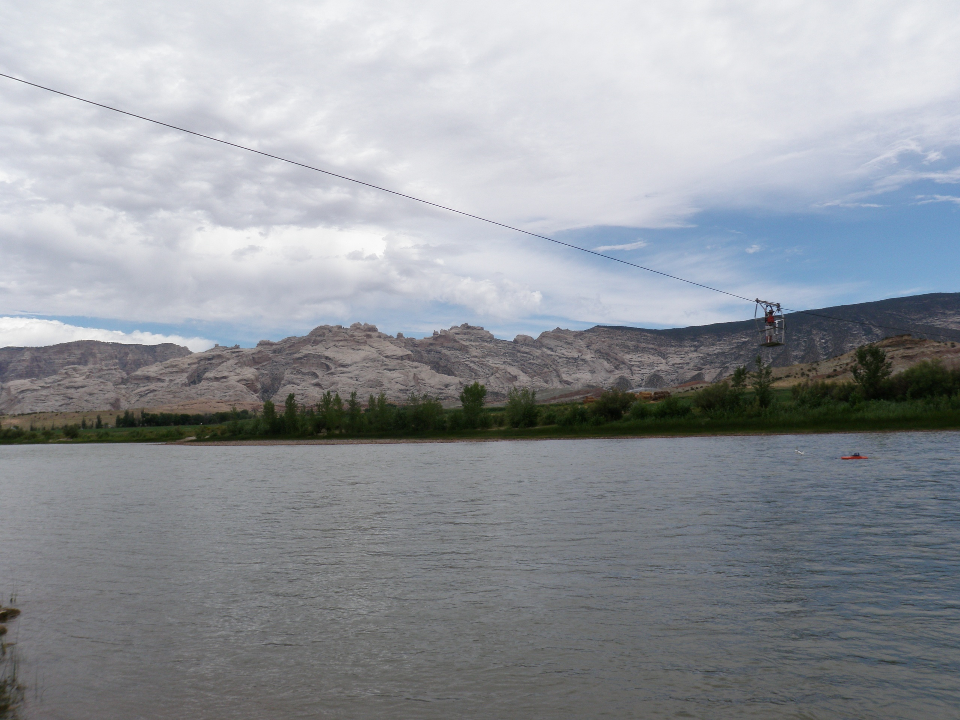
ADCP Tethered to Stand-Up Cableway

Slide 4
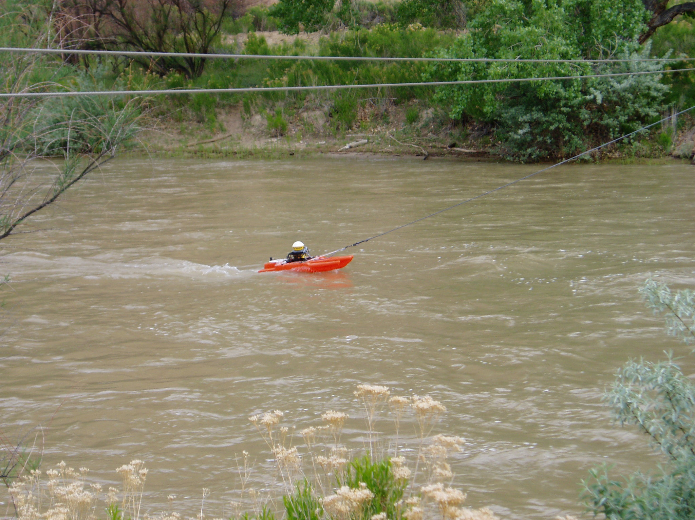
ADCP Deployed From Bank Operated Cableway

Slide 5
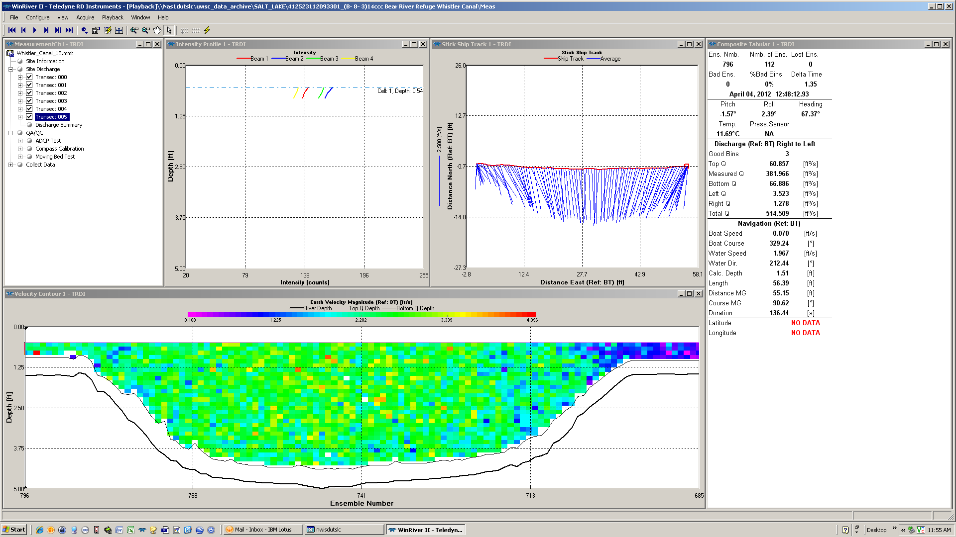
View of complete measurement transect in WinRiver II ADCP measurement program

Slide 6
WinRiver II Measurement Summary Sheet

Slide 7
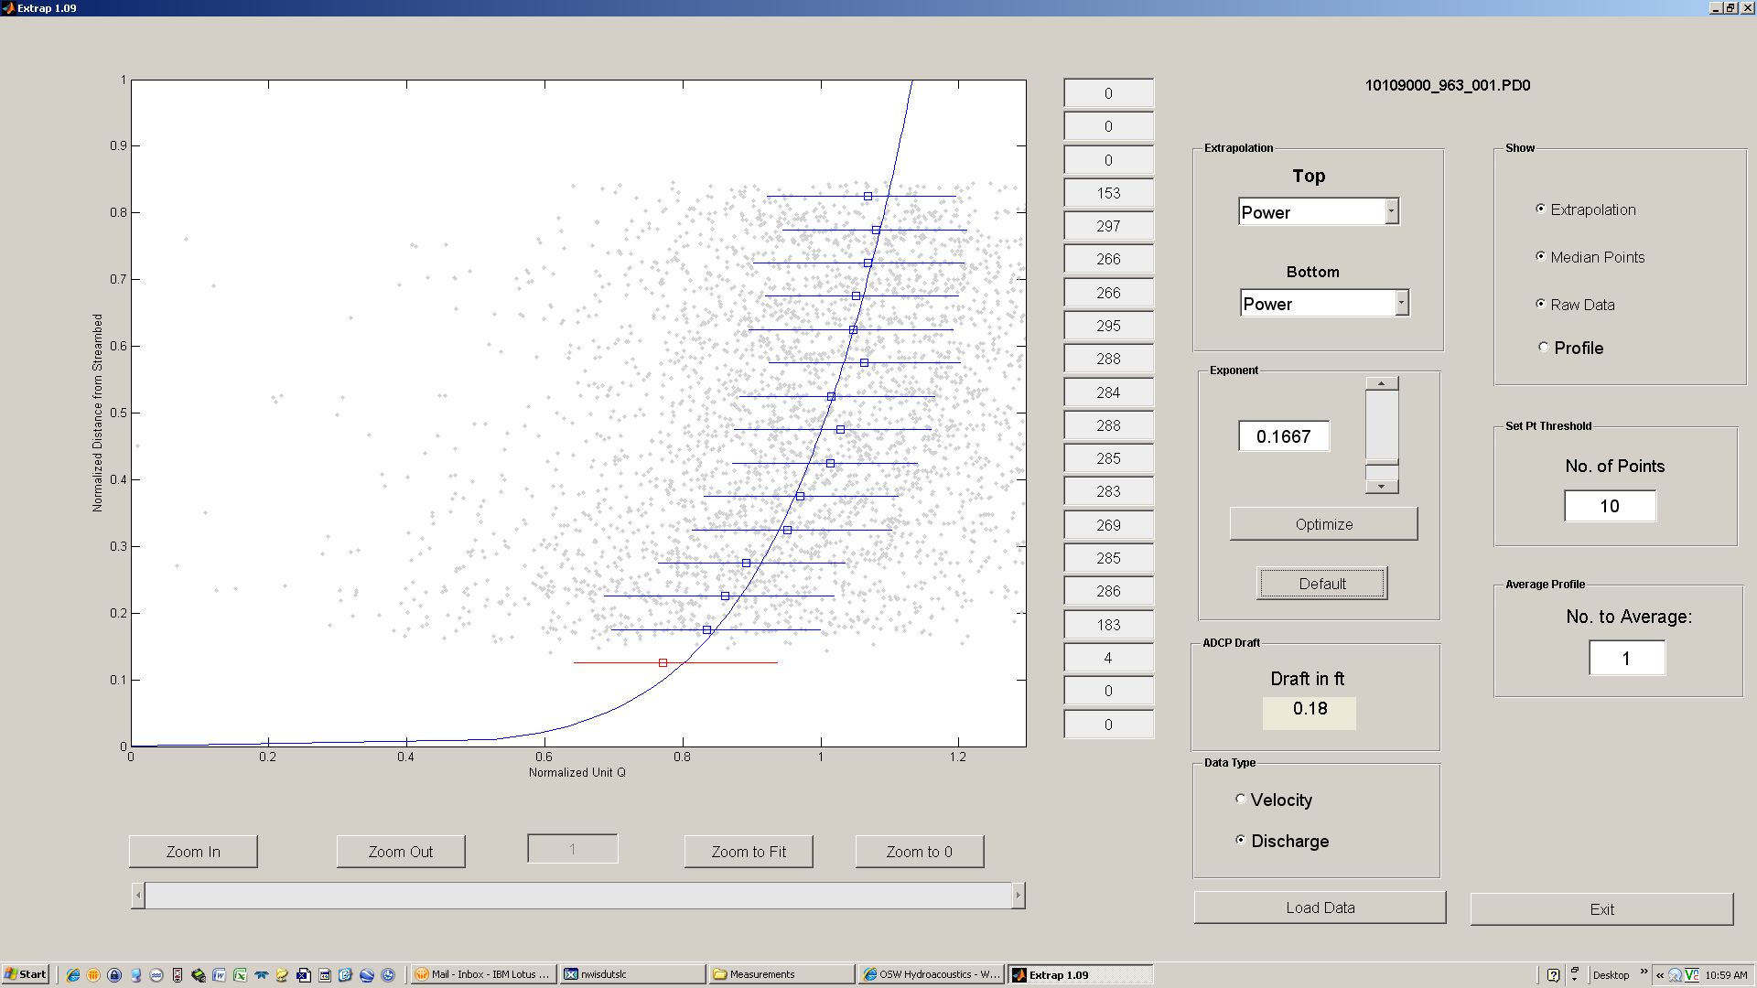
ADCP does is not capable of measuring a portion of the top and bottom of the river. WinRiver II would estimate the top and bottom discharge for the measurement based on these segments of the power curve.
Using extrap program to view a 0.1667 power curve velocity profile found in a ‘typical’ natural river channel. No adjustment would be necessary for this measurement.

Slide 8
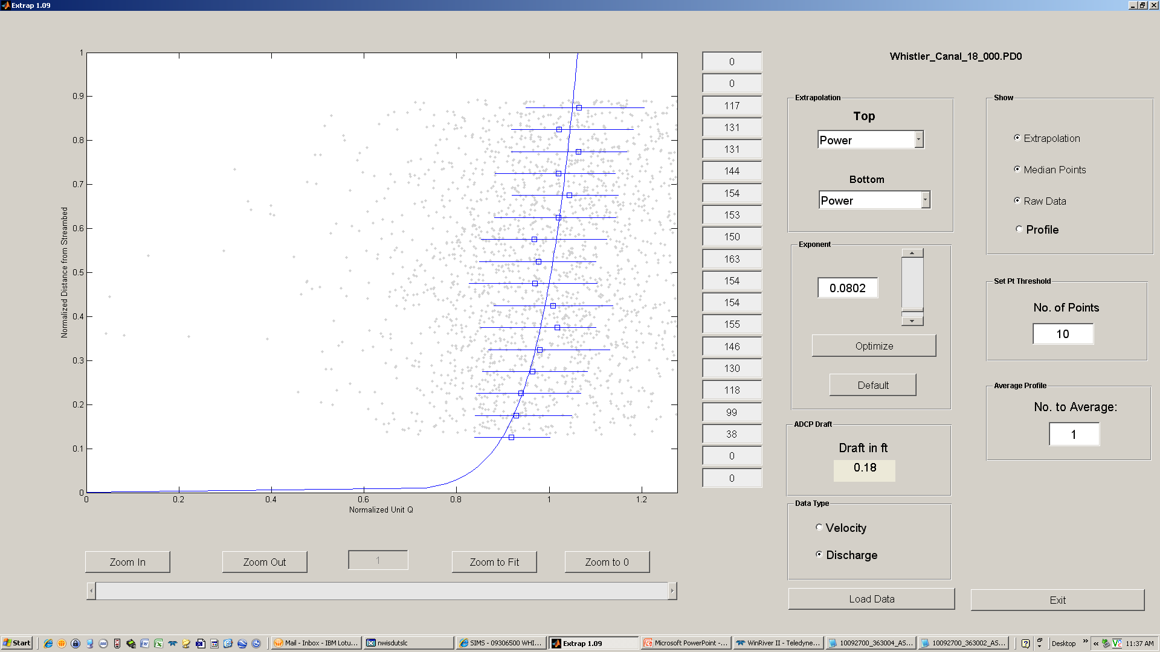
Top and bottom discharge may need to be adjusted based on these segments of the curve.
Here the velocity profile has changed due to water backing up against bridge piers downstream of the measuring section. Power curve exponent can be adjusted manually or optimized by extrap and a 0.0802 power curve might be applied to the measurement in WinRiver II to adjust the top and bottom discharge estimates. An adjustment like this sometimes changes the total computed discharge by 2-3 %.

Slide 9
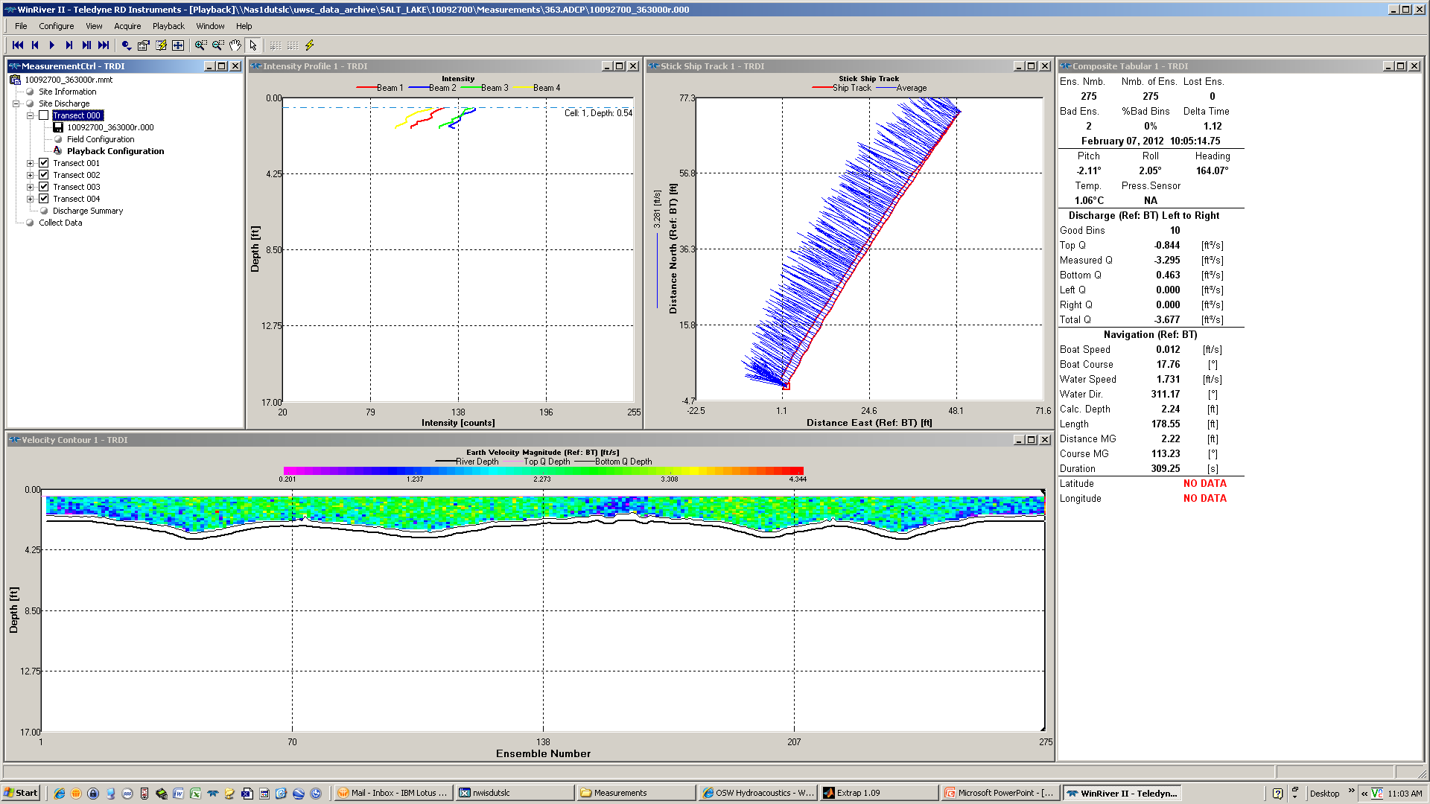
Out and back segments are close together, indicating no moving bed.
A loop moving bed test where no moving bed was found and no adjustment was required

Slide 10
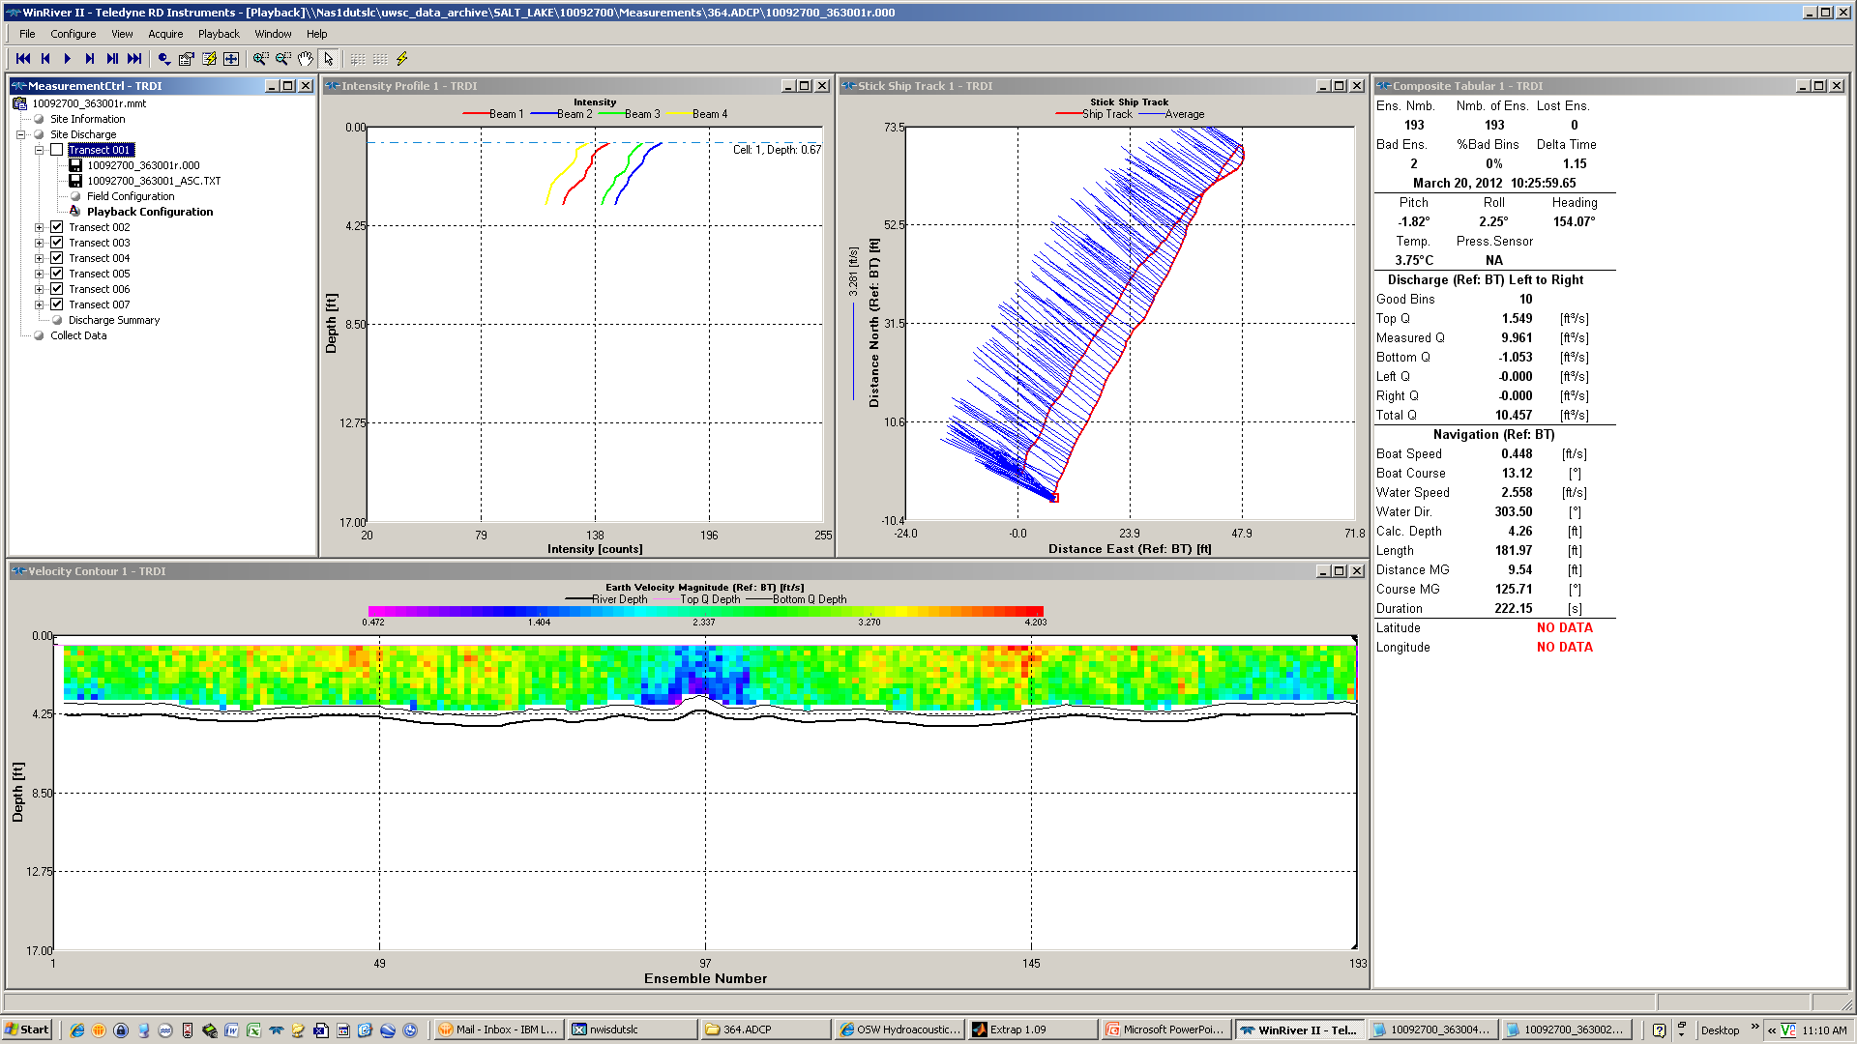
Out and back segments are separated indicating that a moving bed may be present
If a moving bed is present and the ADCP uses bottom tracking the instrument will ‘think’ it’s moving upstream during the measurement and measured discharge may be artificially high. A correction can be applied based on a moving bed loop test.

Slide 11
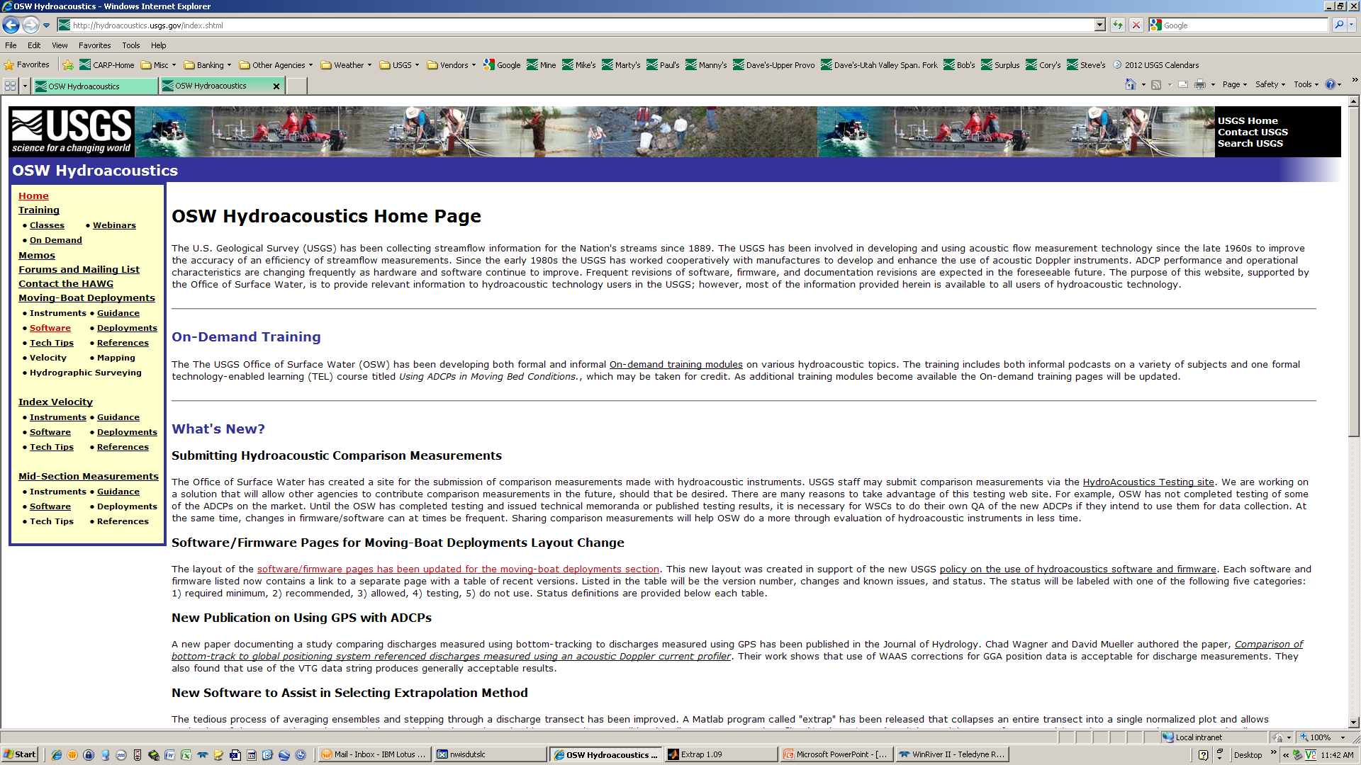
http://hydroacoustics.usgs.gov/index.shtml

